Slide 1
Inference

Slide 2
Introduction
Descriptive statistics: conclusions valid for a specific sample.
Inferential statistics: make conclusions about the population from the sample.
The sample must be representative.
Focus on simple random samples: each member of the population has the same probability of being selected in the sample.

Slide 3
Main objective
Estimate parameters characterising the population: e.g. mean, standard deviation.
We estimate those parameters by using sample estimates.
Statistical inference provides the estimated value of the parameter(s) and their precision of estimation.

Slide 4
Parametric vs non-parametric estimation
In parametric estimation problems, we make an assumption about the distribution of the population (e.g. normal distribution).
Otherwise, we talk about a non-parametric estimation problem.

Slide 5
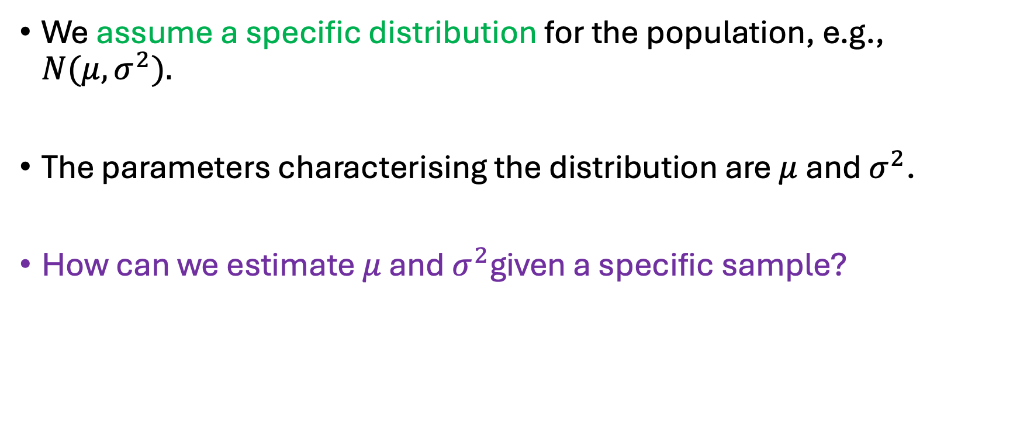
Point estimators
We assume a specific distribution for the population, e.g., $N(μ,σ^{2}).$
The parameters characterising the distribution are $μ$ and $σ^{2}$.
How can we estimate $μ$ and $σ^{2}$given a specific sample?

Slide 6
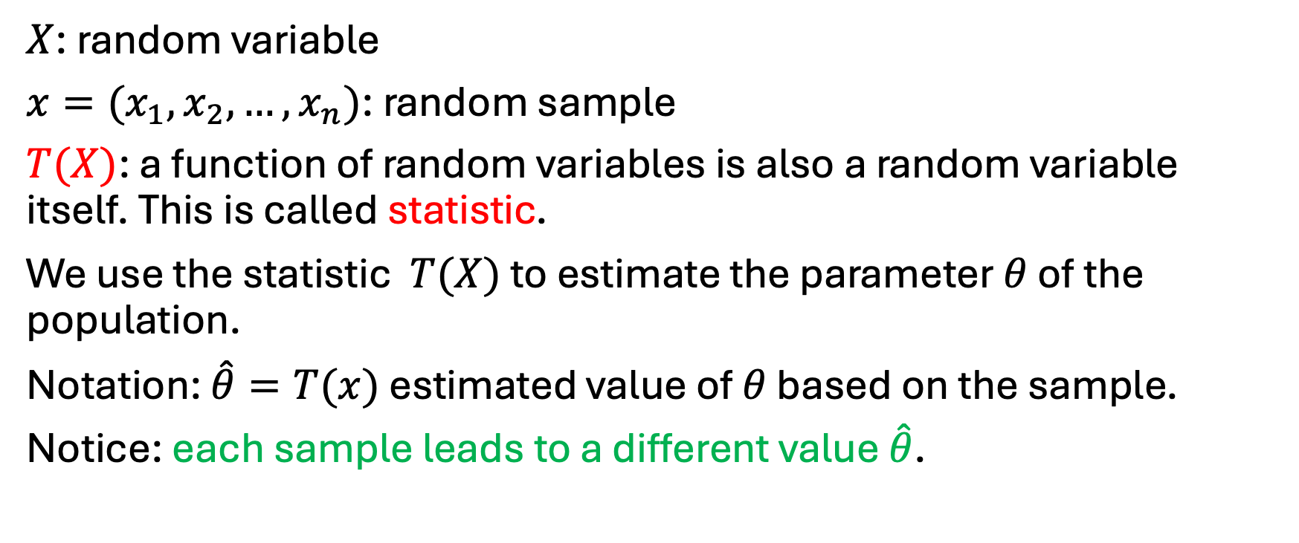
Point estimators
$X$: random variable
$x=(x_{1}, x_{2},…, x_{n})$: random sample
$T(X)$: a function of random variables is also a random variable itself. This is called statistic.
We use the statistic $T(X)$ to estimate the parameter $θ$ of the population.
Notation: $\hat{θ}=T(x)$ estimated value of $θ$ based on the sample.
Notice: each sample leads to a different value $\hat{θ}$.

Slide 7

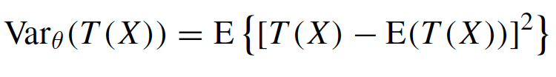

Bias and variance of estimators
The subindex $θ$ indicates that we calculate the expectation with respect to the distribution whose parameter is $θ$.
“Good” estimator: bias and variance as small as possible
(but it is not possible to minimise both simultaneously)

Slide 8

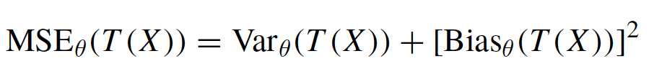
Mean squared error
It can be shown that:
Hence, the mean squared error can be used to compare different estimators. The smaller MSE, the better the estimator.
Common strategy: choose unbiased estimator and try to minimise variance.

Slide 9
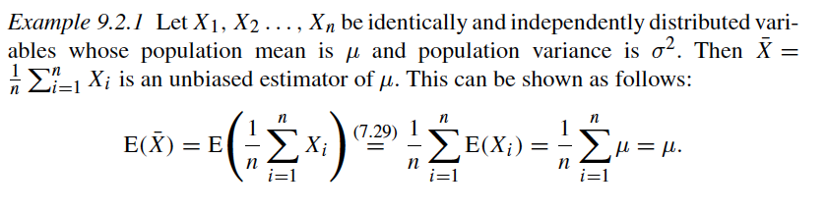


Estimator for $μ$
The arithmetic mean is an unbiased estimator of the expected value, with variance $σ^{2}/n$.

Slide 10

Estimator for $μ$
The arithmetic mean is an unbiased estimator of the expected value, with variance $σ^{2}/n$.

Slide 11
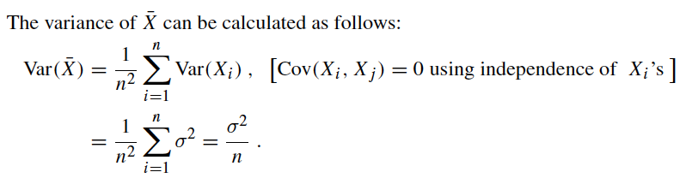

Slide 12
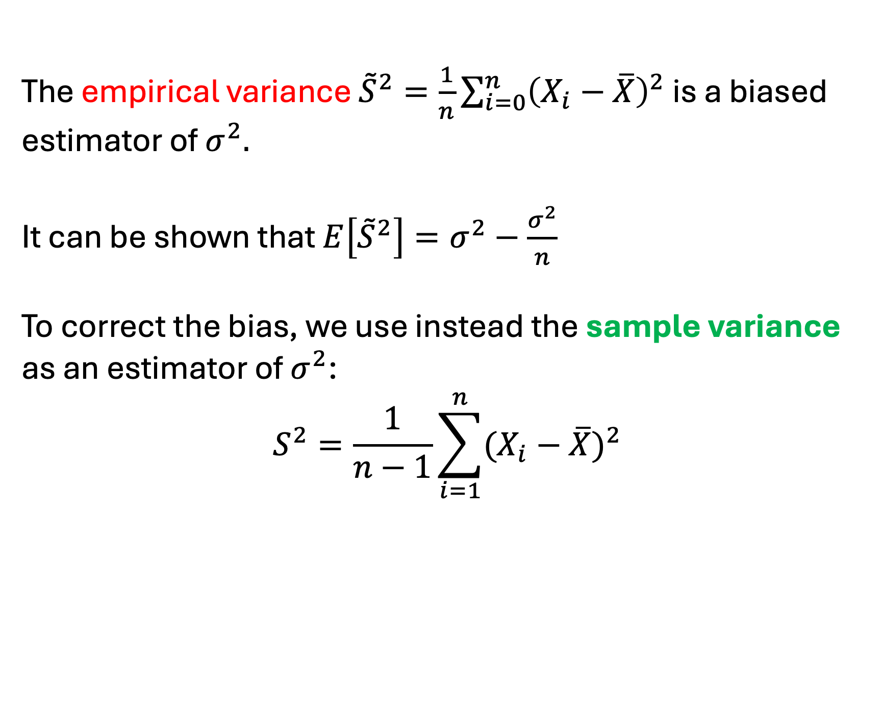

Estimator for $σ^{2}$
The empirical variance ${\tilde{S}}^{2}=\frac{1}{n}\sum_{i=0}^{n}{{\left(X_{i}−\overline{X}\right)}^{2}}$ is a biased estimator of $σ^{2}.$
It can be shown that ${E\left[{\tilde{S}}^{2}\right]=σ}^{2}−\frac{σ^{2}}{n}$
To correct the bias, we use instead the sample variance as an estimator of $σ^{2}$:
$$S^{2}=\frac{1}{n−1}\sum_{i=1}^{n}{{(X_{i}−\overline{X})}^{2}}$$

Slide 13

It can be shown that the variance of the sample variance is equal to:
$$Var\left(S^{2}\right)=\frac{2σ^{4}}{n−1}$$

Slide 14
Degrees of freedom
The number of degrees of freedom refers to the number of independent values or quantities that can vary in an analysis while still satisfying given constraints.
Example: n data points, constraint: mean value.
If we know all data points except one, we can determine it exactly. Hence, only n-1 values are free to vary → n-1 degrees of freedom.
When we calculate the sample variance, we first calculate the sample mean. Given that mean, we have only n-1 degrees of freedom. Hence, the sample variance has only n-1 degrees of freedom.

Slide 15
Confidence interval
Example:
A person travels every day from their home to the train station.
This person notes the time for 20 days and calculates the arithmetic mean: 25 minutes
Not every day the travel time will be 25 minutes exactly: it may vary by a few minutes every day.
To take this variability into account we might find the time varies mostly between 20 and 30 minutes.
This statement in form of an interval describes both expectation and variation.

Slide 16
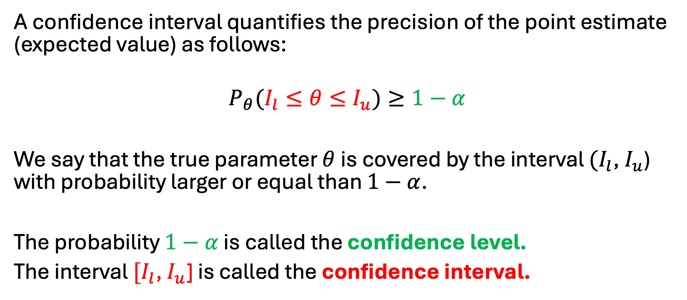
Confidence interval
A confidence interval quantifies the precision of the point estimate (expected value) as follows:
$$P_{θ}(I_{l}≤θ≤I_{u})≥1−α$$
We say that the true parameter $θ$is covered by the interval $(I_{l}$, $I_{u}$) with probability larger or equal than $1−α$.
The probability $1−α$ is called the confidence level.
The interval $[I_{l}$, $I_{u}$] is called the confidence interval.

Slide 17
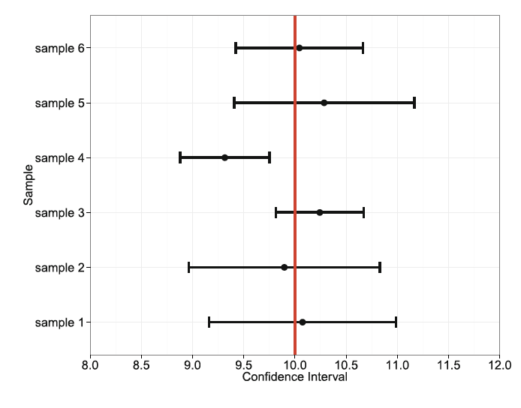
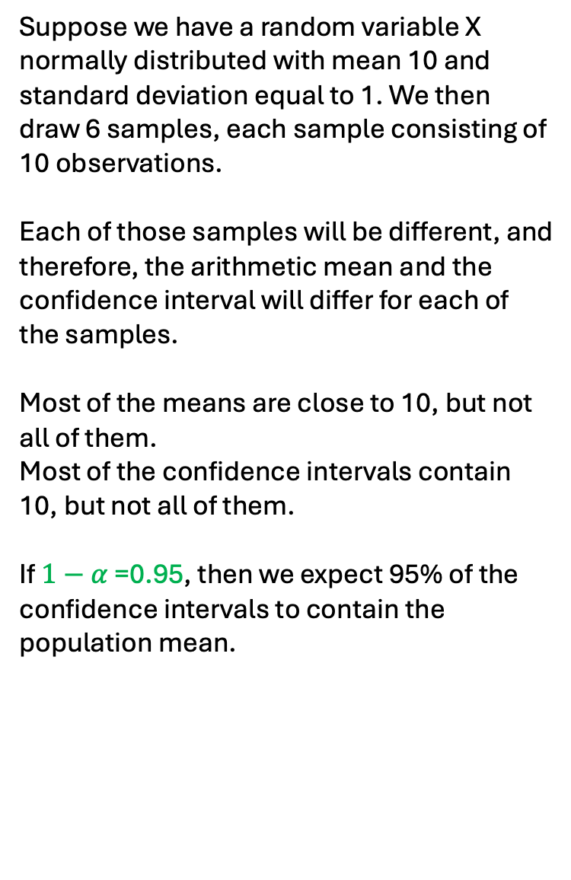
Confidence interval
Suppose we have a random variable X normally distributed with mean 10 and standard deviation equal to 1. We then draw 6 samples, each sample consisting of 10 observations.
Each of those samples will be different, and therefore, the arithmetic mean and the confidence interval will differ for each of the samples.
Most of the means are close to 10, but not all of them.
Most of the confidence intervals contain 10, but not all of them.
If $1−α$ =0.95, then we expect 95% of the confidence intervals to contain the population mean.

Slide 18
Confidence interval for the mean of a normal distribution
But how do we calculate the confidence interval?
We will distinguish between 2 cases:
When variance of distribution of population known
When variance of distribution of population unknown

Slide 19
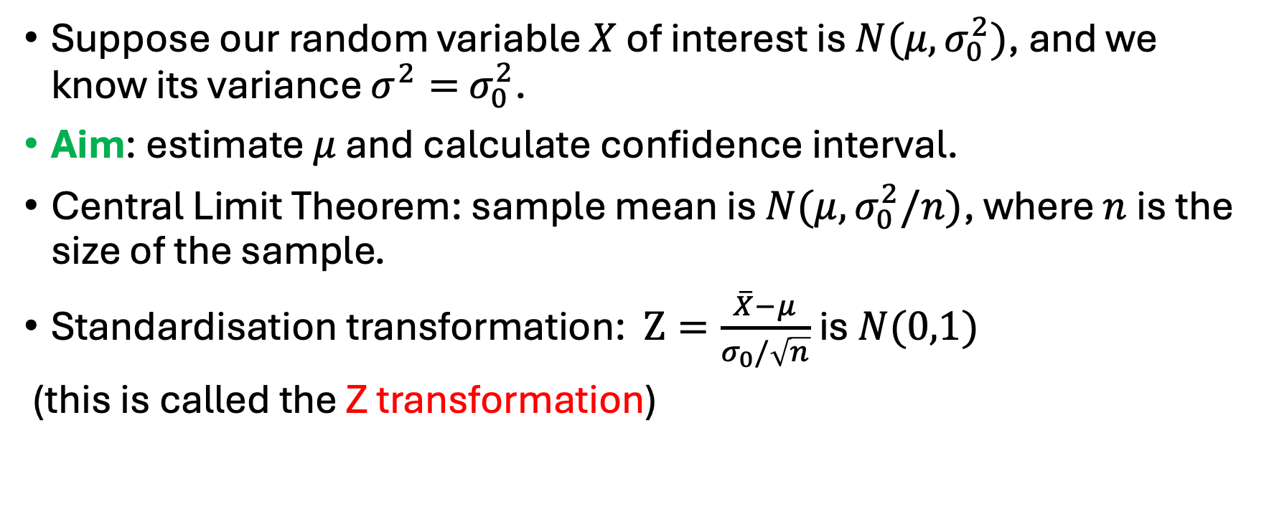
Confidence interval for the mean of a normal distribution: known variance
Suppose our random variable $X$ of interest is $N(μ,σ_{0}^{2})$, and we know its variance $σ^{2}=$ $σ_{0}^{2}$.
Aim: estimate $μ$ and calculate confidence interval.
Central Limit Theorem: sample mean is $N(μ,σ_{0}^{2}/n)$, where $n$ is the size of the sample.
Standardisation transformation: $Z=\frac{\overline{X}−μ}{σ_{0}/\sqrt{n}}$ is $N(0,1)$
(this is called the Z transformation)

Slide 20
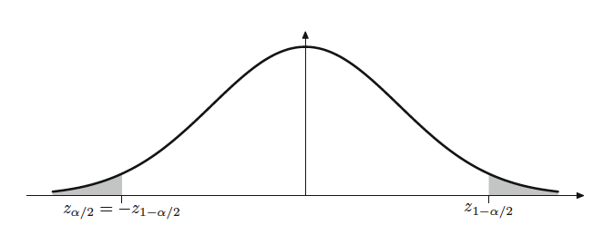



We are interested in the following probability:
$$P_{μ}\left(I_{l}≤\frac{\overline{X}−μ}{\frac{σ_{0}}{\sqrt{n}}}≤I_{u}\right)=1−α$$
$$I_{l}$$
0
$$I_{u}$$

Slide 21

We are interested in the following probability:
$$P_{μ}\left({−z}_{1−\frac{α}{2}}≤\frac{\overline{X}−μ}{\frac{σ_{0}}{\sqrt{n}}}≤z_{1−\frac{α}{2}}\right)=1−α$$
0

Slide 22


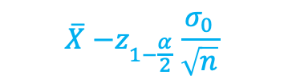

Rearranging terms:
$$P_{μ}\left(\overline{X}{−z}_{1−\frac{α}{2}}\frac{σ_{0}}{\sqrt{n}}≤μ≤\overline{X}+z_{1−\frac{α}{2}}\frac{σ_{0}}{\sqrt{n}}\right)=1−α$$
$$\overline{X}{−z}_{1−\frac{α}{2}}\frac{σ_{0}}{\sqrt{n}}$$
$$μ$$
$$\overline{X}{+z}_{1−\frac{α}{2}}\frac{σ_{0}}{\sqrt{n}}$$

Slide 23
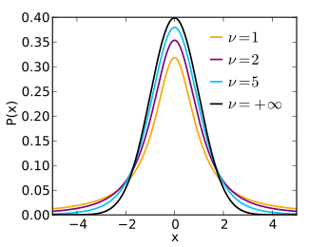
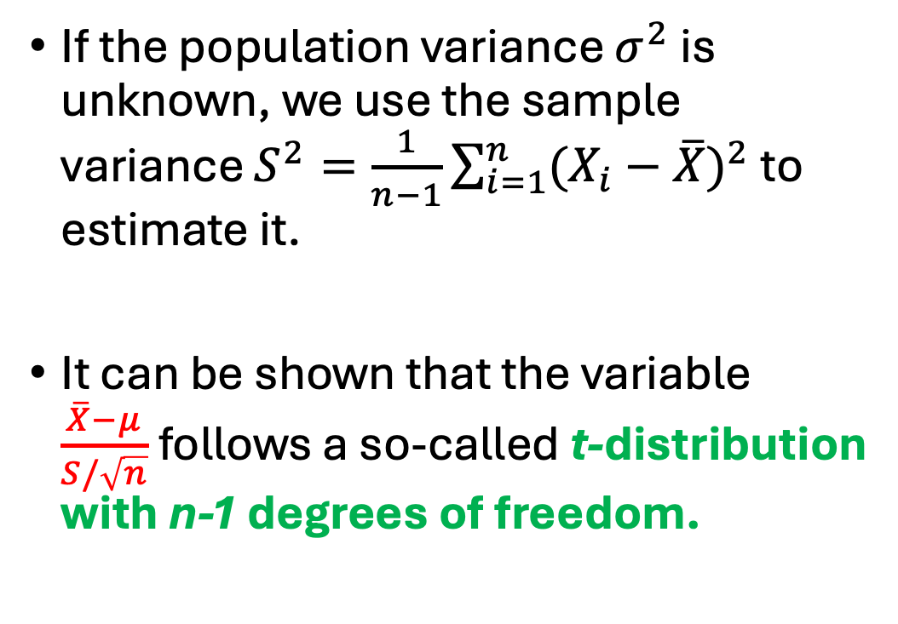
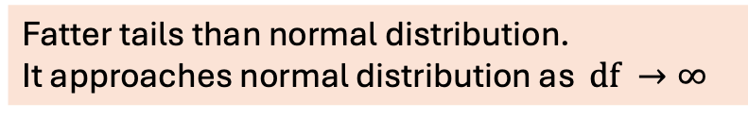

Confidence interval for the mean of a normal distribution: unknown variance
If the population variance $σ^{2}$ is unknown, we use the sample variance $S^{2}=\frac{1}{n−1}\sum_{i=1}^{n}{{(X_{i}−\overline{X})}^{2}}$ to estimate it.
It can be shown that the variable $\frac{\overline{X}−μ}{S/\sqrt{n}}$follows a so-called t-distribution with n-1 degrees of freedom.
$$ν≡df$$
Fatter tails than normal distribution.
It approaches normal distribution as $df →∞$

Slide 24
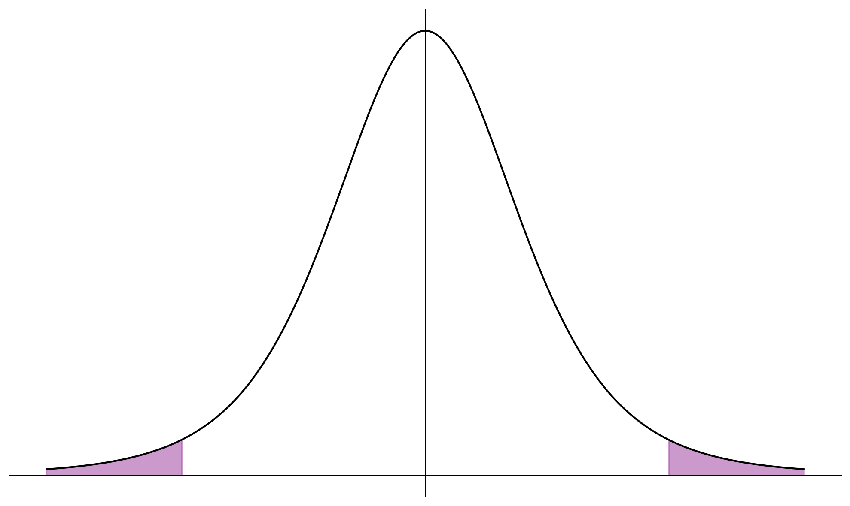



We are interested in the following probability:
$$P_{μ}\left(I_{l}≤\frac{\overline{X}−μ}{\frac{S}{\sqrt{n}}}≤I_{u}\right)=1−α$$
$$I_{l}$$
0
$$I_{u}$$

Slide 25


We are interested in the following probability:
$$P_{μ}\left(I_{l}≤\frac{\overline{X}−μ}{\frac{S}{\sqrt{n}}}≤I_{u}\right)=1−α$$
$${−t}_{1−\frac{α}{2} , n−1}$$
0
$$t_{1−\frac{α}{2} , n−1}$$

Slide 26


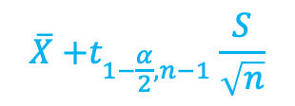
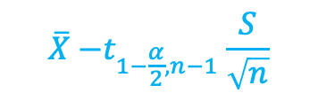
Rearranging terms:
$$P_{μ}\left(\overline{X}{−t}_{1−\frac{α}{2}, n−1}\frac{S}{\sqrt{n}}≤μ≤\overline{X}+t_{1−\frac{α}{2}, n−1}\frac{S}{\sqrt{n}}\right)=1−α$$
Notice: confidence interval in this case
wider than for normal distribution for same $α$ and sample size n due to uncertainty about variance.
$$\overline{X}{−t}_{1−\frac{α}{2}, n−1}\frac{S}{\sqrt{n}}$$
$$μ$$
$$\overline{X}{+t}_{1−\frac{α}{2}, n−1}\frac{S}{\sqrt{n}}$$

